Slide 1

CAPSTONE PROJECT
SECURE DATA HIDING IN IMAGE USING
STEGANOGRAPHY
Presented By: Narsing Joshna
Student Name : Narsing Joshna
College Name & Department : Rayalaseema University College
of Engineering & Electronics and Communication Engineering

Slide 2

OUTLINE
○ Problem Statement
○ Technology used
○ Wow factor
○ End users
○ Result
○ Conclusion
○ Git-hub Link

Slide 3
PROBLEM STATEMENT
Image Steganography in Python
Overview
This project demonstrates an image Steganography tool implemented in Python,which allows users to embed secret
messages within images for secure communication.The application provides a Graphical User Interface(GUI) that lets users
easily encrypt and decrypt hidden messages within image files using a passcode for added security.This project is an excellent
example of how Python can be used for image manipulation and data security.
Features :
Encrypt and Decrypt Messages : Hide and Retrieve secret messages inside images.
GUI Interface : Simple and user friendly interface built with python.
Passcode Protection : Secure encryption and decryption using a passcode.
Cross-Platform Support : Runs on python 3.7+,Windows,macOS,Linux.
Image File Support : Works with standard Image formats like JPG.
Real-Time Status Updates : Displays Status messages during the encryption and decryption process.

Slide 4
TECHNOLOGY USED
Programming Language : Python
Libraries/ Frameworks:
• OpenCV library (for manipulating Images,and Videos,Object detection)
• Openstego (for data hiding and watermarking)
• Stegano (for write a secret message by the sender and transfer it to the receiver)
• Python ImageIO (for reading and write a wide range of image data)
• Python File Handling (for file operations)

Slide 5
WOW FACTORS
1. Advanced Steganography
2. Multi-Format Support
3. High Payload Capacity
4. Security Enhancements
5. Real-World Applications
6. Robust Anti-Detection Mechanisms
7. User friendly Features
8. Multi-Mode Data Extraction
9. AI & Machine Learning Integration
10. Trap Mechanism
11. Portable and Embedded System Support

Slide 6
END USERS
a) Cybersecurity Professionals & Ethical Hackers
b) Government & Military Agencies
c) Journalists & Whistleblowers
d) Corporate & Business Organizations
e) Researchers & Academicians
f) Digital Forensics & Law Enforcement
g) Artists and Content Creators
h) General Public and Privacy Enthusiasts

Slide 7
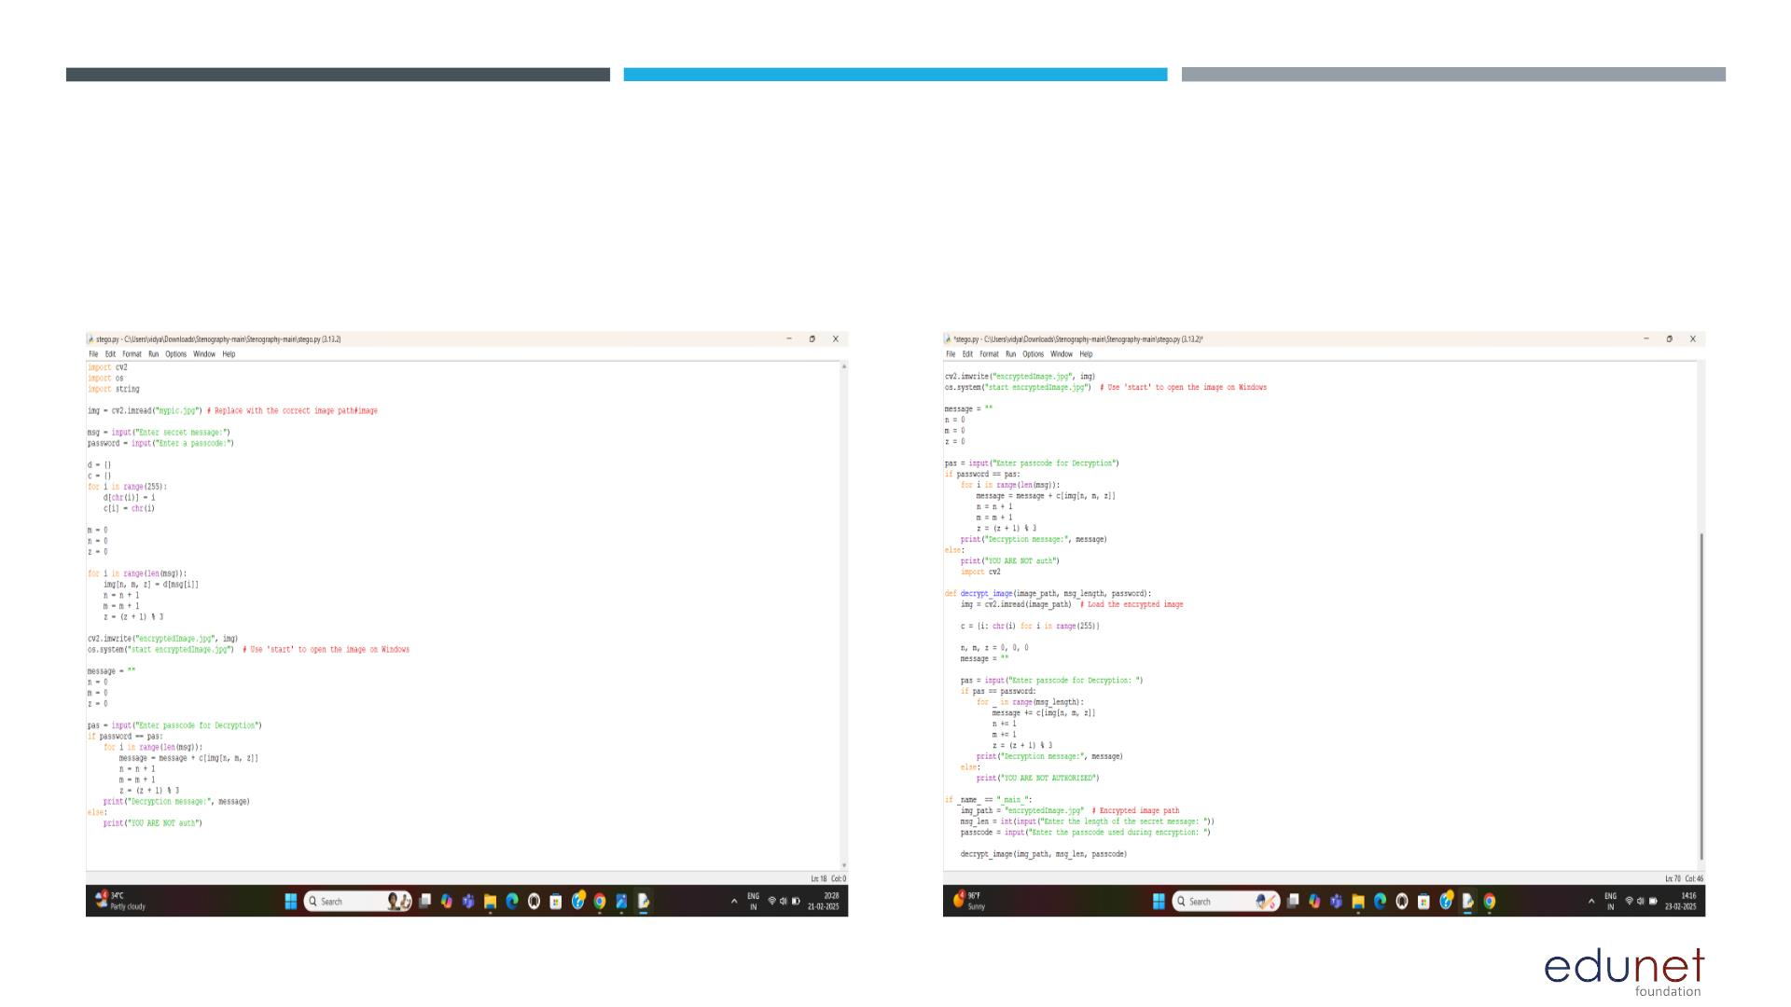
RESULT
ENCRYPTION
DECRYPTION

Slide 8
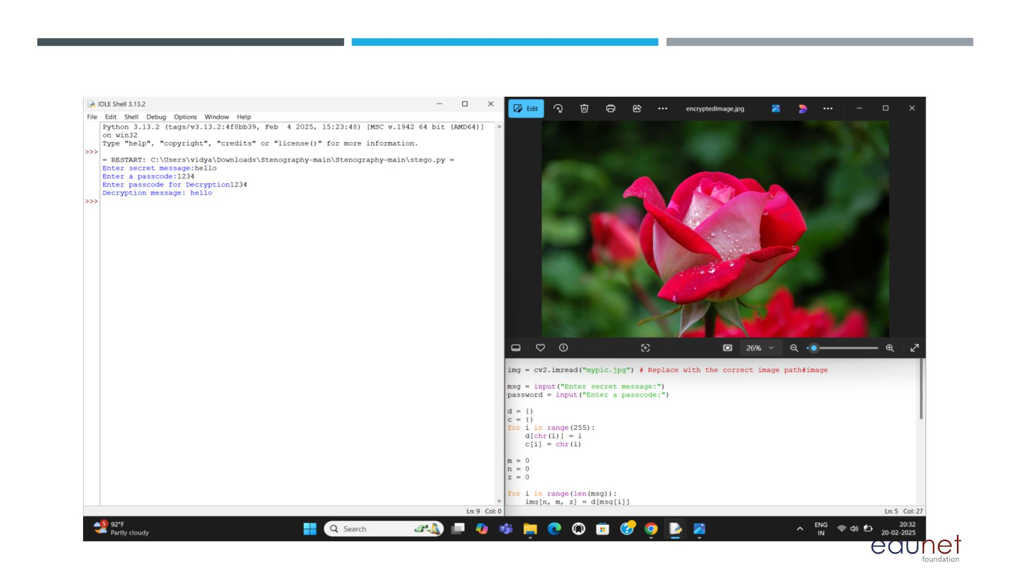
RESULT

Slide 9
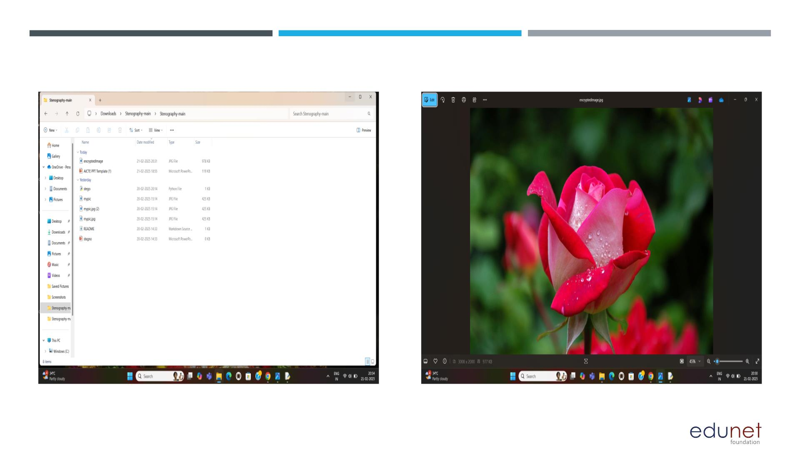
RESULT

Slide 10
CONCLUSION
○ Steganography is a powerfull technique for hiding information within digital media,ensuring secure communication
and data protection.
○ Through this project we explored various steganographic methods,including image,audio,and text based techiques.
○ Steganography remains a valuable tool for secure information exchange,particularly when combined with
encryption for enhanced security.

Slide 11
GITHUB LINK
https://github.com/Joshna2401/project-aicte.git

Slide 12
THANK YOU

